Slide 1


Fundamentals of Management
Concept of Capital Budgeting
by,
1. Singh Garima Sangram (2202556)
2. Tayade Amita Rameshwar (2202557)
3. Thite Aniket Shankar (2202558)
4. Thombare Akshay Nandkumar (2202559)
5. Thorat Bhgyashree Suresh (2202560)
6. Udhayarajan J (2202561)
MODERN INSTITUTE OF BUSINESS STUDIES (AUTONOMOUS)

Slide 2
Introduction
Capital budgeting deals with long-term investment decisions.
It helps decide whether a project is financially beneficial.
Used by companies for expansion and development.

Slide 3
Objectives
Maximize returns
Ensure efficient capital allocation
Evaluate future profits
Improve business efficiency

Slide 4

Meaning / Definition
Capital budgeting is the process of planning and selecting long-term investments.
It evaluates future cash inflows and outflows before investing.

Slide 5
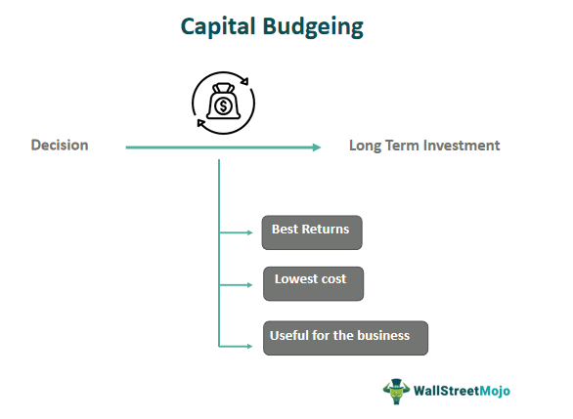
Features
Involves large investment
Long-term impact
Future cash flow estimation
Risk and uncertainty involved
Difficult to reverse decisions

Slide 6
Importance
Helps in selecting profitable projects
Supports long-term growth
Reduces investment risk
Ensures proper use of funds

Slide 7
Types of Capital Budgeting Decisions
Expansion decisions
Replacement of old machines
New product launch
Cost reduction projects
Research & development

Slide 8
Steps in Capital Budgeting
Find investment ideas
Check which ideas are suitable
Estimate future cash inflows and outflows
Evaluate the project using financial methods
Choose the best project
Implement the project
Review the results

Slide 9
Example
Investment: ₹40,000
Annual Cash Inflow: ₹10,000
Payback Period = 40,000 ÷ 10,000 = 4 years
Project will recover its cost in 4 years.

Slide 10

Conclusion
Capital budgeting is essential for choosing good long-term investments.
It helps companies grow, reduce risks, and improve financial planning.

